Slide 1
Advanced Number Theory

Slide 2
Content
Revision
Factorization
Prime Factorization
Sieve of Eratosthenes
Number of Divisors, Sum of Divisors
Modular Arithmetic, Exponentiation
Euclidean Algorithm
Euler’s Totient Function
Euler’s Theorem
Fermat’s Little Theorem
Extended Euclidean Algorithm
Linear Diophantine Equations
Modular Inverse

Slide 3
1. Revision

Slide 4
Factorization: Find all factors of a number N
Naive way
Check every number for factor from 1 to N
O(N)
Factors occur in pairs
N = P * Q
Without loss of generality if P < Q => P <= sqrt(N)
Efficient way
Check for every P from 1 to sqrt(N). Q = N / P
O(sqrtN)

Slide 5
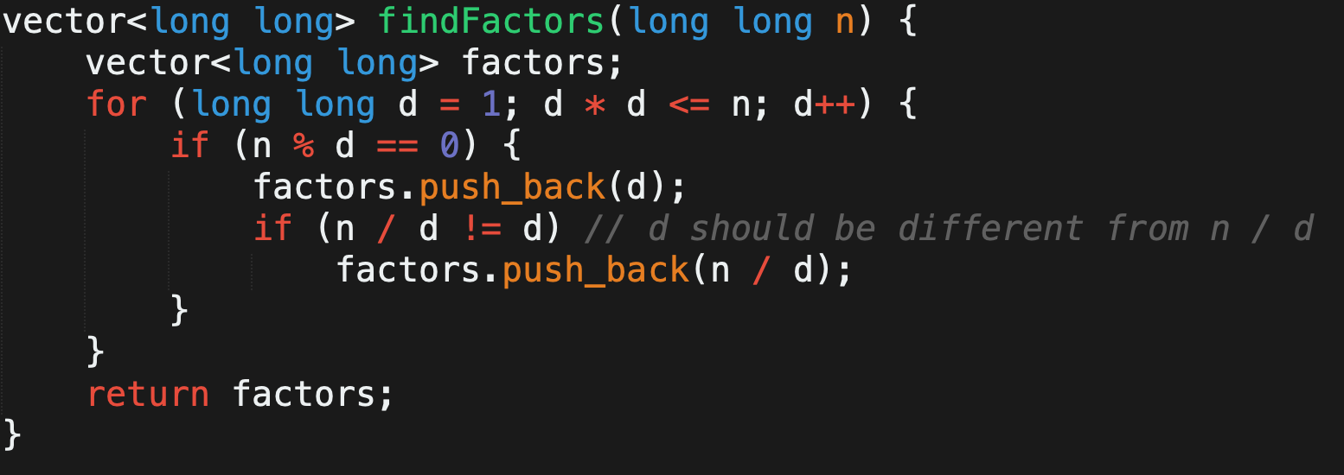
Factorization: Find all factors of a number N
Implementation (Efficient way)

Slide 6
Prime Factorization: Represent N as p₁^{k1} p₂^{k2}…… p_{m}^{km}
Naive way
Find all factors of N.
Check each number for prime
Find how many times each prime divides N
Efficient way
Only one of the prime factors of N can be > sqrt(N)
Iterate from 2 to sqrt(N)
Check if current number divides N. If yes, keep dividing N by that number as many times as possible
Invariant: any new number that will divide N now will be a prime number
O(sqrtN)

Slide 7
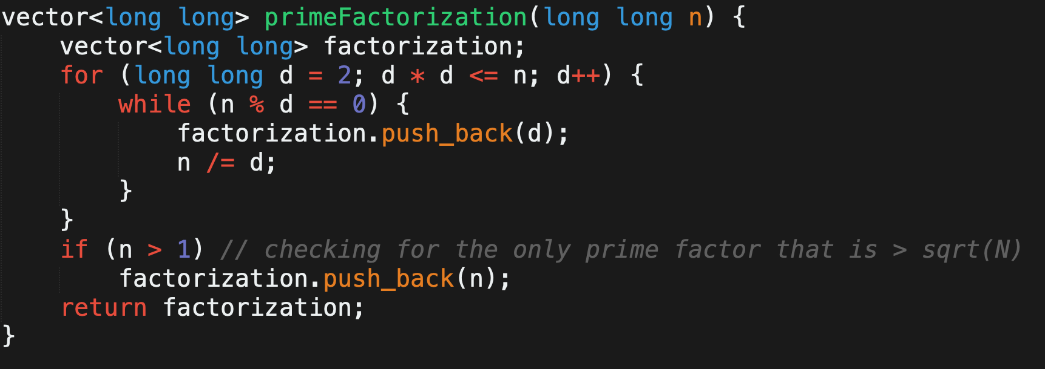
Prime Factorization: Represent N as p₁^{k1} p₂^{k2}…… p_{m}^{km}
Implementation (Efficient way)

Slide 8
Sieve of Eratosthenes: Find all prime numbers from 1 to N
Naive way
Iterate from 1 to N
Check if current number is prime: O(sqrtN) or O(logN) using Miller Rabin
Time: O(NrootN), Space: O(1)
Efficient way
Iterate from 2 to N
Keep marking numbers as non primes by iterating on multiples of primes
If current number (X) is unmarked -> X is Prime
Mark all multiples of X as non-prime
Time: O(Nlog(logN)), Space: O(N). Proof

Slide 9
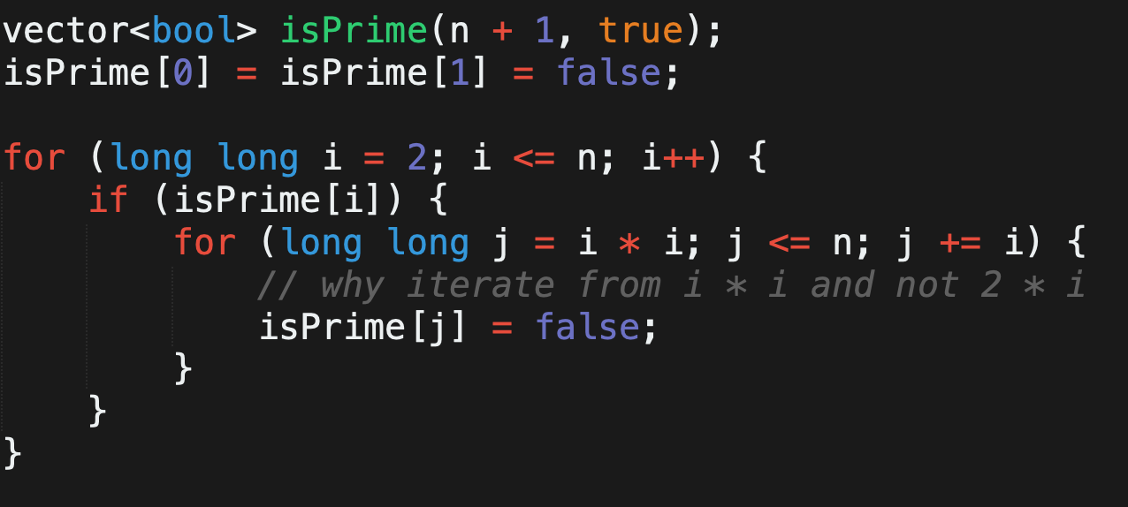
Sieve of Eratosthenes: Find all prime numbers from 1 to N
Implementation (Efficient way)

Slide 10
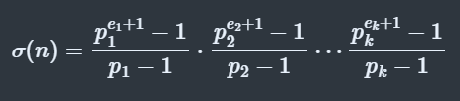
Number and Sum of Divisors from Prime Factorization: Problem
N = p₁^{e1} p₂^{e2}…… p_{k}^{ek}
Number of Divisors:
d(n) = (e1 + 1) * (e2 + 1) * … * (ek + 1)
Sum of Divisors:

Slide 11
Modular Arithmetic: Link
(A + B) % M = ((A % M) + (B % M)) % M
(A - B) % M = ((A % M) - (B % M) + M) % M
(A * B) % M = ((A % M) * (B % M)) % M
(A / B) % M = ((A % M) * (B⁻¹ % M)) % M
What is B⁻¹ % M = Modular Inverse (Later in the lecture)

Slide 12
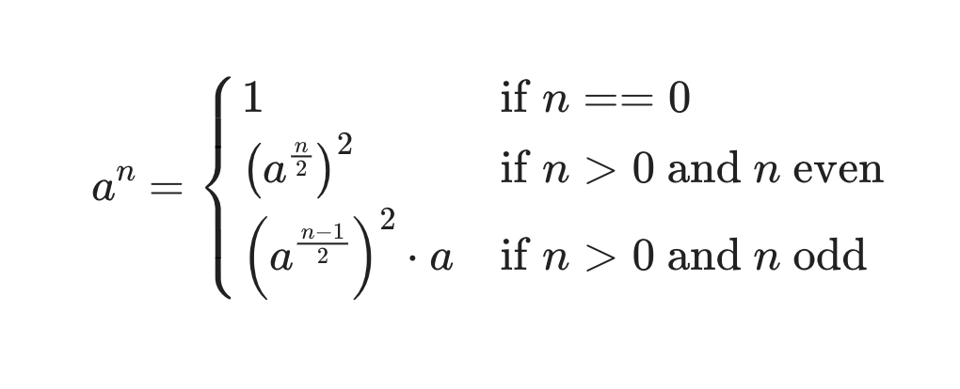
Binary Modular Exponentiation: Link
Idea:
Time Complexity: O(log(n))

Slide 13
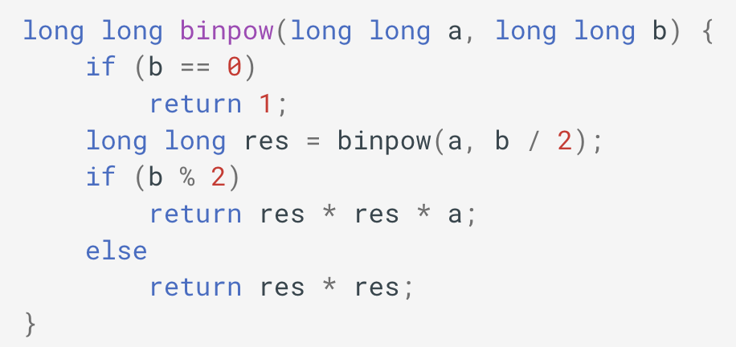
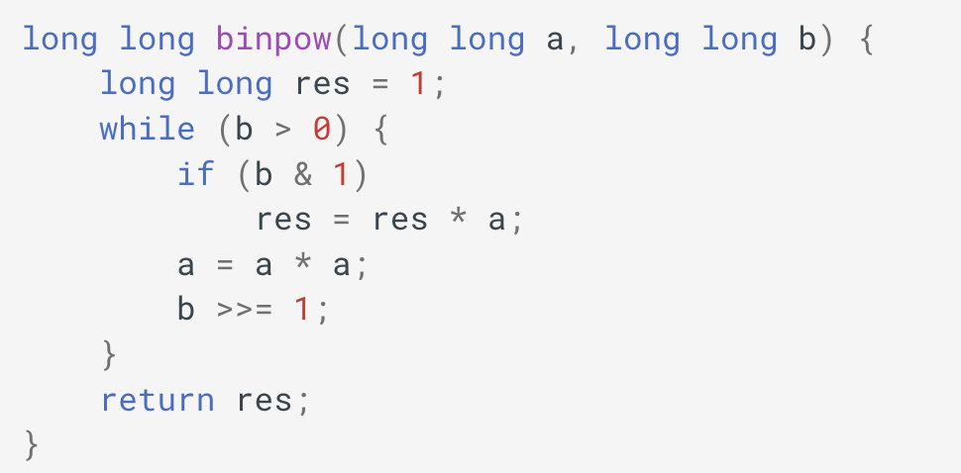
Binary Modular Exponentiation: Link
Implementation: (Don’t forget to take MOD when mentioned in problem)
Recursive
Iterative

Slide 14
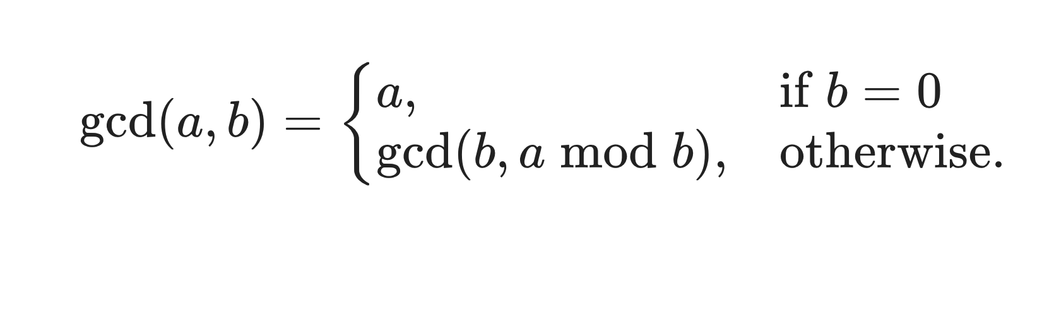
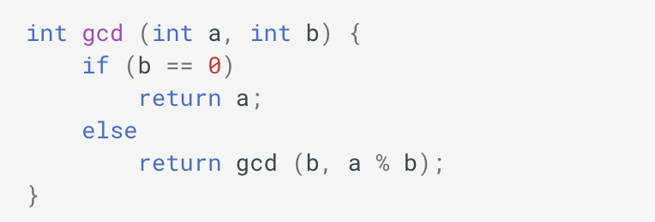
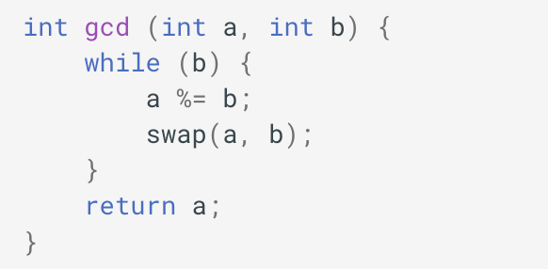
Euclidean Algorithm: Link
Theorem:
Implementation:
Recursive
Iterative
Time Complexity: O(log(min(a, b))) Proof

Slide 15
2. Euler’s Totient Function

Slide 16
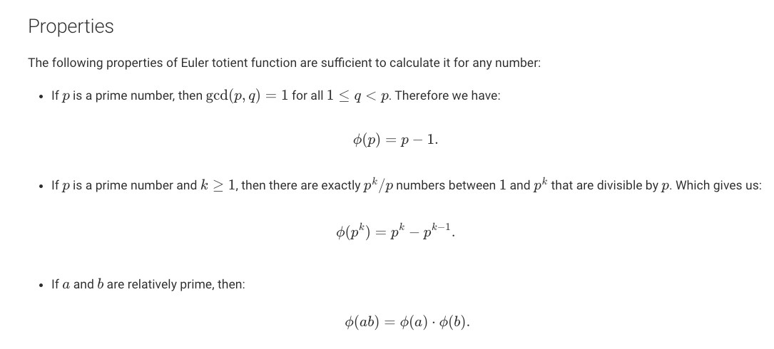
Euler’s Totient Function: Link to study further
Find phi(N) = number of values X such that X <= N and gcd(X, N) = 1
phi(N) is a multiplicative function. Multiplicative?

Slide 17
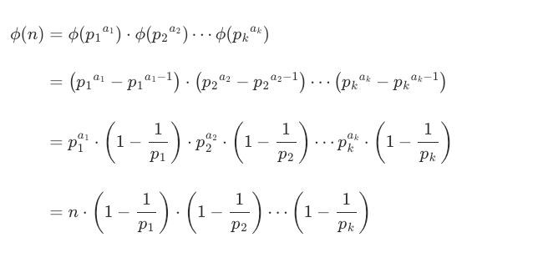
Euler’s Totient Function:
Idea:

Slide 18
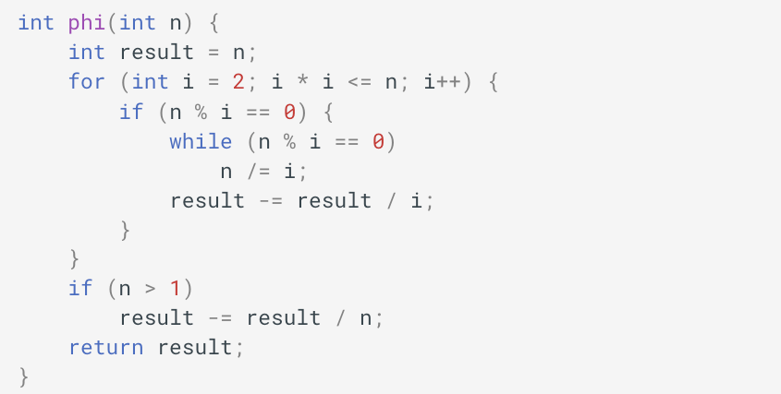
Euler’s Totient Function:
Implementation:

Slide 19
Euler’s Totient Function:
Bonus (Homework):
- Find phi(x) for all numbers from 1 to N. Link
- Divisor sum property. Link

Slide 20
3. Euler’s and Fermat’s Theorem

Slide 21


Euler’s Theorem and Fermat’s Theorem: Link
Euler’s Theorem
Fermat’s Theorem
Sample Problem: Link

Slide 22
Euler’s Theorem and Fermat’s Theorem: Link
Using this to find Multiplicative Modular Inverse
To find X such that AX = 1 mod M
We know A^{phi(M)} = 1 mod M
X = A^{phi(M) - 1}
Time Complexity to Find X now?
M not a prime: O(sqrtM) + O(log(phi(M)))
M is a prime: O(1) + O(log(M - 2))

Slide 23
4. Extended Euclidean Algorithm

Slide 24
Extended Euclidean Algorithm: Link to study further
Used to find solutions for equation:
ax + by = gcd(a, b)
Applications:
To find GCD of two numbers.
Finding modulo inverse
Finding solutions to Linear Diophantine Equations

Slide 25
Solving equation ax + by = gcd(a, b) for given (a, b)
ax + by = g [equation 1]
Let us solve a different equation: bx₁ + (a mod b) * y₁ = g [equation 2]
a mod b = b - (a / b) * b [Floor division] [equation 3]
ax + by = bx₁ + (a - (a / b) * b) y₁ = ay₁ + b (x₁ - (a / b)y₁) [combining 1, 2 and 3]
x = y₁ , y = x₁ - (a / b) * y₁

Slide 26
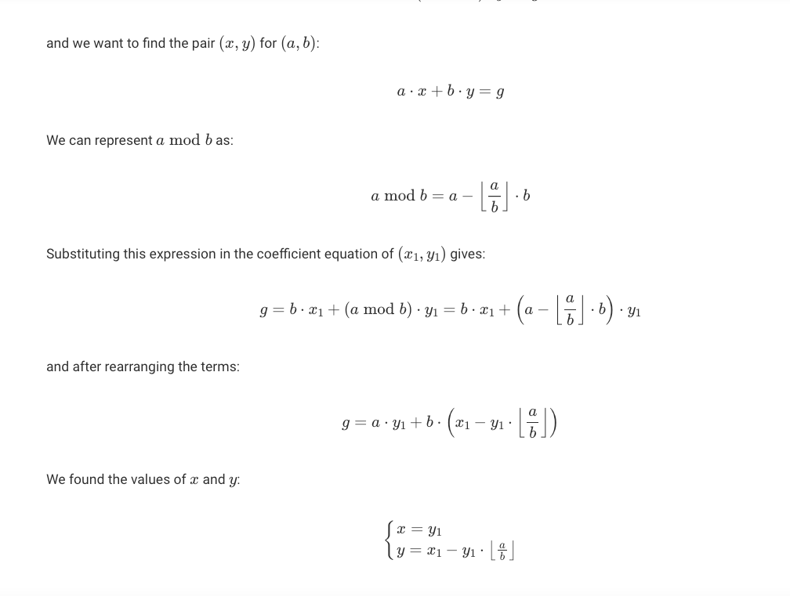
Idea:
Base case:
ax + by = g, and b = 0
solution: x = 1 and y = 0, as gcd(a, 0) = a

Slide 27
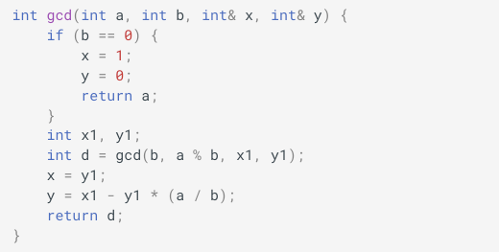
Extended Euclidean Algorithm Implementation:
Same as that of normal Euclidean Algorithm. This time we are also keeping track of x and y
Invariant:
gcd(a, b, x, y) will return gcd(a, b) but will also update (x, y) for the solution of ax + by = gcd(a, b)

Slide 28
5. Linear Diophantine Equations

Slide 29
Solving linear diophantine equation using EEA:
Find a solution for the equation ax + by = c (Note here c might not be gcd(a, b)).
A degenerate case that need to be taken care of is when a=b=0. It is easy to see that we either have no solutions or infinitely many solutions, depending on whether c=0 or not. In the rest of this article, we will ignore this case.
We know there exist a solution for the equation: ax + by = gcd(a, b) Why? Proof
ax + by = g
multiply by c/g both side
ax + by = c ( c should be a multiple of g for solution to exist )

Slide 30
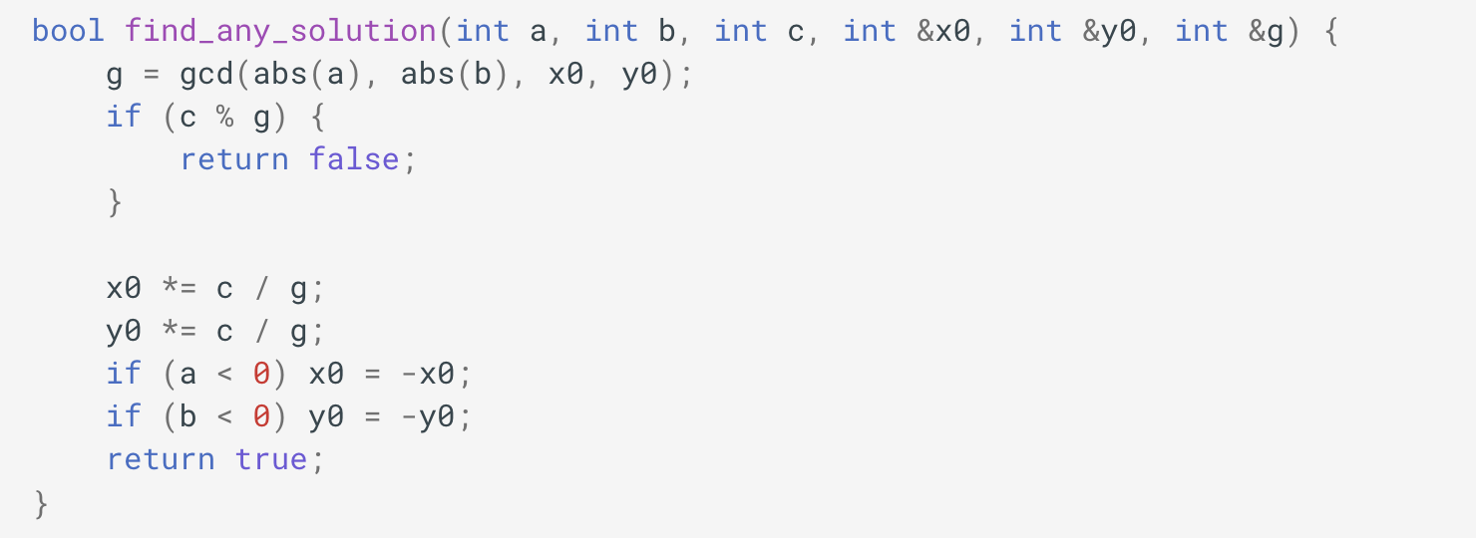
Solving linear diophantine equation using EEA:
Find a solution for the equation ax + by = c (Note here c might not be gcd(a, b)).
Implementation
Bonus Problem Read about chicken nugget theorem

Slide 31
6. Modular Inverse

Slide 32
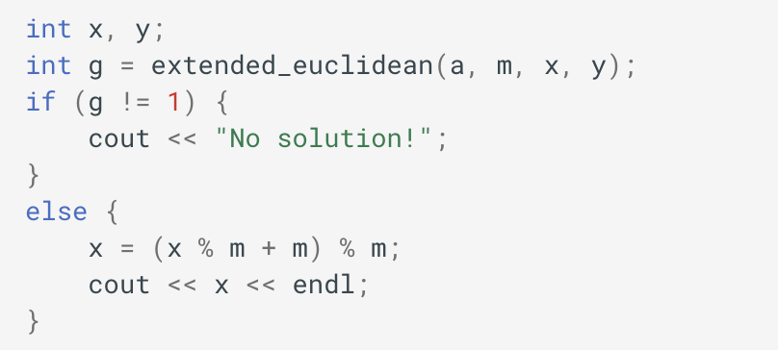
Finding Modulo Inverse of a number using EEA:
Find _a such that (a * _a) % m = 1
Consider the equation:
ax + my = 1, (there exist a solution only when gcd(a, m) = 1)
ax = 1 mod m
_a = x.
Implementation:

